Slide 1
PP8 Genetic Issues
Year 10 Science

Slide 2
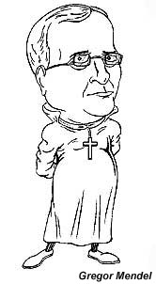
Timeline of discovery of DNA
1866
Gregor Mendel published the results of his investigations of the inheritance of "factors" in pea plants.
Did not know how traits were passed on

Slide 3
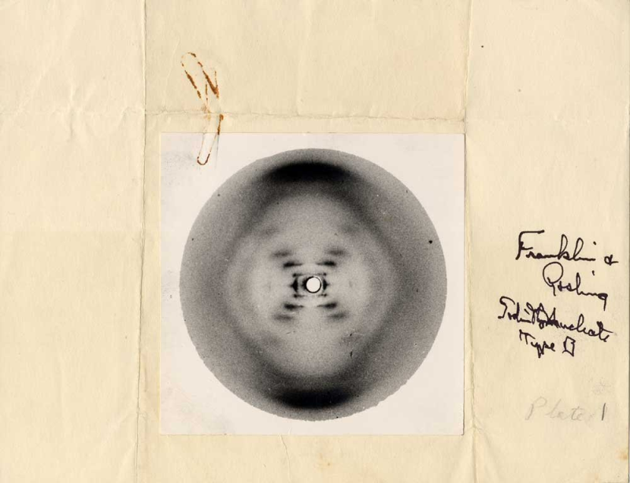

1952
Rosalind Franklin
Was a biophysicist and X-Ray crystallographer who investigated structure of DNA
Provided images which would later help Watson and Crick

Slide 4
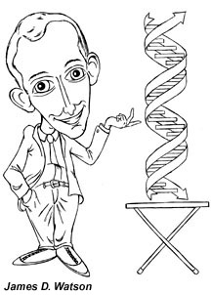
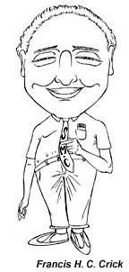
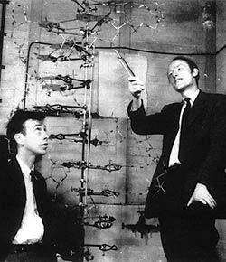
1953
Watson and Crick made a model of the DNA molecule and proved that genes determine heredity.

Slide 5

1957
Arthur Kornberg
Produced DNA in a test tube.

Slide 6

1963
F. Sanger
Developed sequencing procedure for DNA
(this means to work out the order of the bases in DNA)

Slide 7
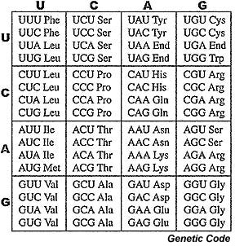
1966
The Genetic code was discovered; scientists were then able to predict characteristics by studying DNA.
This lead to genetic engineering and genetic counselling.

Slide 8
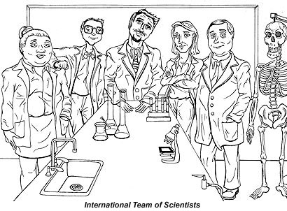
The Late 1980's
An international team of scientists began the project to map the human genome.
The first crime conviction based on DNA fingerprinting, in Portland Oregon.

Slide 9
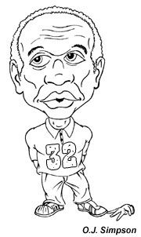
1995
DNA testing in forensics cases gains fame in the O.J. Simpson trial.

Slide 10

2000
J. Craig Ventor, along with Francis Collins, jointly announce the sequencing of the entire human genome.
3 billion bases pairs long
Fast computers and people skilled in appropriate computing made this project possible

Slide 11
Genetic Disease?
There are many diseases that can be inherited.
Some people can be “carriers” of genetic disease without showing symptoms themselves – this depends if the trait is dominant or recessive
Some genetic diseases show symptoms at birth and others not until later in life
Some can be easily managed and others are fatal

Slide 12
What is Genetic Testing?
….a type of medical test that identifies changes in chromosomes, genes, or proteins.
The results of a genetic test can confirm or rule out a suspected genetic condition or help determine a person’s chance of developing or passing on a genetic disorder to their children
More than 1,000 genetic tests are currently in use, and more are being developed.

Slide 13
Types of Genetic testing
Several methods can be used for genetic testing:
Gene tests study single genes to identify faults that lead to a genetic disorder.
Eg Huntingdons disease
Chromosomal tests analyse whole chromosomes or long lengths of DNA to see if there are large genetic changes, such as an extra copy of a chromosome, that cause a genetic condition.
Eg Downs Syndrome or Klinefelters
Biochemical tests study the amount or activity level of proteins; abnormalities in either can indicate changes to the DNA that result from a genetic disorder.
Eg PKU

Slide 14
Pros and Cons
Genetic testing is voluntary.
Testing has benefits as well as limitations and risks,
The decision about whether to be tested is a personal and complex one.
A geneticist or genetic counsellor can help by discussing the pros and cons and the social and emotional aspects of testing
Who should have the right to know – Family? insurance companies? Employers? Would you be given the same opportunities if they did or didn’t know?

Slide 15
Some points to think about
http://www.youtube.com/watch?v=9b88wwMxM_I
http://www.youtube.com/watch?v=71kpMgX0v2A
https://www.youtube.com/watch?v=WC25Yoh8cPc

Slide 16
In vitro fertilisation
In vitro fertilisation (IVF) is medical technology where the fertilisation of an egg and a sperm are done in a test tube
The embryo is grown for 3-5 days before being transferred into the mothers womb in the hope that it will implant
This technology is designed for couples who for many reasons may not be able to conceive naturally

Slide 17
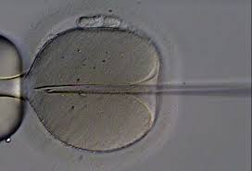
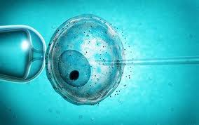
In vitro fertilisation

Slide 18
Embryo Selection
The fertilised egg (called the blastocyst) is viewed under a microscope and ones that are growing at the correct rate are chosen to be implanted
There are specialised genetic tests now available to determine if the embryo is carrying any genetic disorders

Slide 19
Why test an embryo?
Previous pregnancy with genetic disorder
One of the parents with a disorder or both carriers
In some countries, couples can chose the gender of the embryo to be implanted
It is not lawful in Australia to chose gender unless there is risk of a sex linked disorder
Just because we can? Should we?

Slide 20
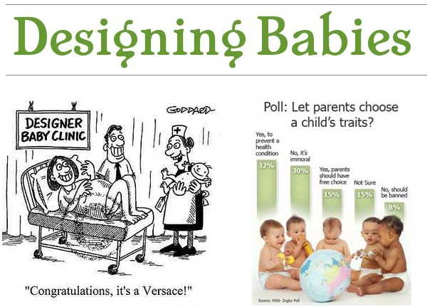

Slide 21
Who should know?
If a person gets tested for a genetic disorder, should they “have” to tell others
Eg; health or life insurance policies ask for pre existing conditions?
Lots of bio ethics issues surrounding genetic technologies

Slide 22
Ethical principals
Autonomy
Informed consent
Understand risks and benefits
Free of coaxing or cohersion – must be own choice
Justice
fair distribution of scarce resources,
Reproductive technologies create ethical dilemmas because treatment is not equally available to all people.
Beneficence
Provides an overall benefit – more good than harm
This is to the individual and society
Non-maleficence
Cannot be the cause of harm

Slide 23
Gene Therapy
Gene therapy is an experimental technique that uses genes to treat or prevent disease.
In the future, this technique may allow doctors to treat a disorder by inserting a gene into a patient’s cells instead of using drugs or surgery.

Slide 24
How does it work?
Researchers are testing several approaches to gene therapy, including:
Replacing a mutated gene that causes disease with a healthy copy of the gene.
Inactivating, or “knocking out,” a mutated gene that is functioning improperly.
Introducing a new gene into the body to help fight a disease.

Slide 25
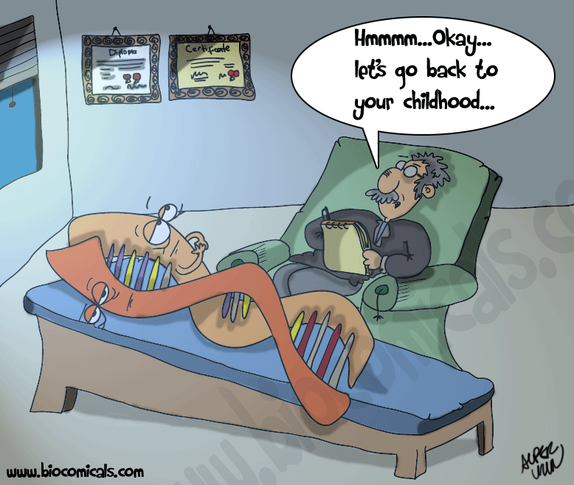

Slide 26
Genetic Engineering
is the process of manually adding new DNA to an organism.
The goal is to add one or more new traits that are not already found in that organism.
Examples of genetically engineered (transgenic) organisms;
plants with resistance to some insects,
plants that can tolerate herbicides,
crops with increased yields (fruits/oils)
Bacteria producing human products
Spider silk in goats milk

Slide 27

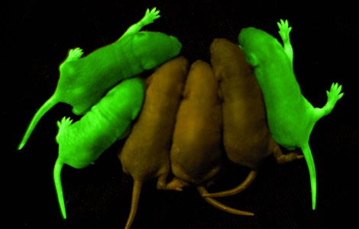
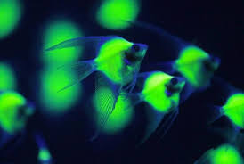
Sheldon’s night light

Slide 28
Manufacturing biological molecules
Some diseases/disorders affect hormones or other materials that are manufactured in one part of the body, then transported by the blood to where they are required
Eg Insulin, produced by the pancreas controls the level of glucose in the blood, or growth hormone produced by the pituitary gland
We can use common bacteria, and insert a gene that codes for a desired protein into it, and get the bacteria to manufacture that protein

Slide 29
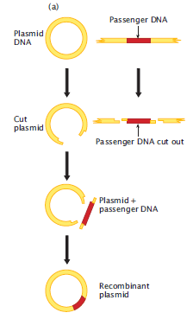
Plasmids
Circular DNA found in some bacteria
Can be used as a vector or carrier to take desired gene
Into a cell

Slide 30
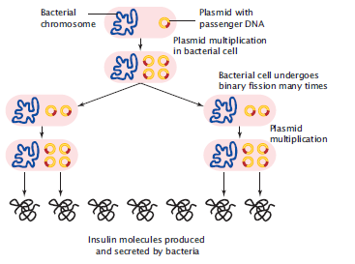

Slide 31
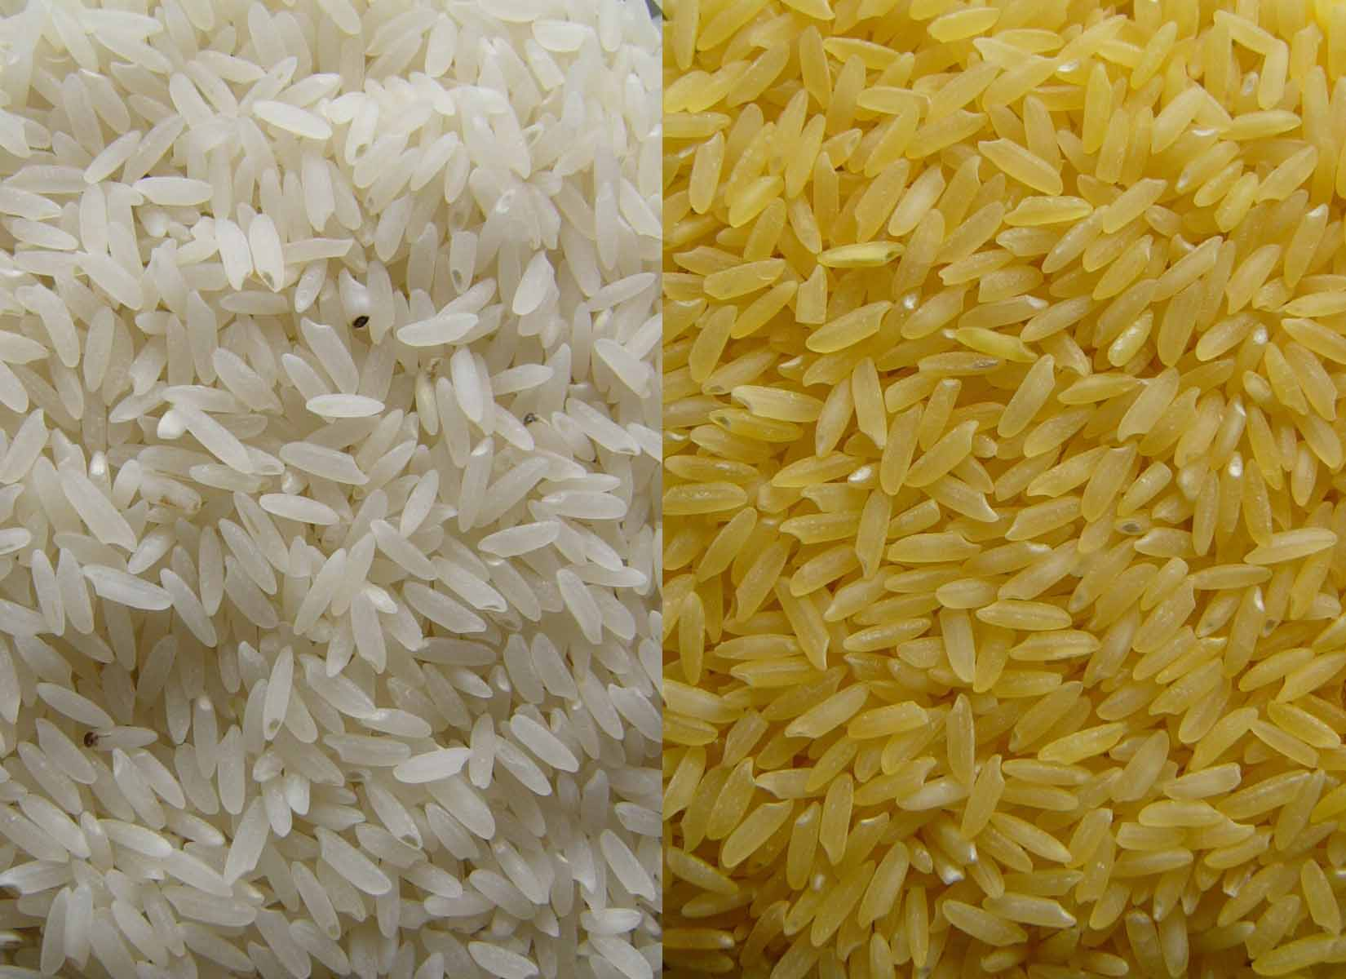
Yellow rice
Rice is low in vitamin A
The orange color (beta carotene) in carrots is a rich source of vitamin
The beta carotene gene has successfully been transferred into rice
Huge health implications in third world countries
Lots of controversy about
Genetically modified (GM)
Foods. What do you think?

Slide 32
CAT
Use these ideas as a basis for completing the bio ethics component of the “Genetics disorder and bioethics” research CAT

